Slide 1
Multi-objective optimization using genetic algorithms
Mikhail Gaerlan
Computational Physics
8 December 2015

Slide 2
Definitions
Optimization – minimization (maximization)
Objective – function to optimize
Single-objective – one function
Multi-objective – two or more functions
Genetic algorithm – optimization algorithm which uses the principles of evolutionary biology
Genetic operator – selection, crossover, mutation
Population – set of solutions
Individual – single solution
Pareto front – set of non-dominated solutions

Slide 3
Genetic Algorithm
Initialization
Selection
Mutation
Criteria Met?
No
Crossover
Yes
Termination

Slide 4
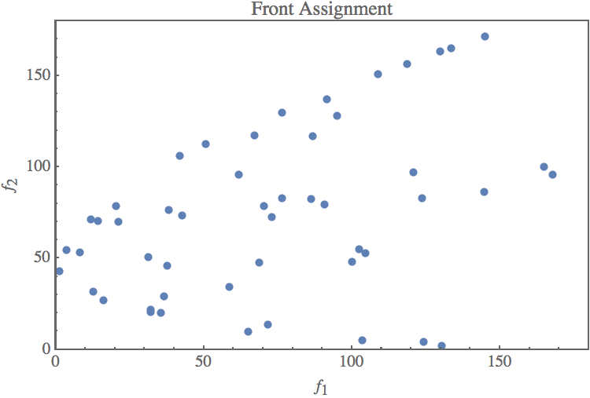
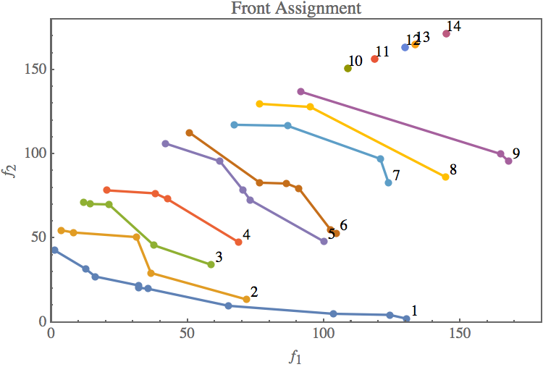
Selection

Slide 5
Crossover
One-point crossover
Two-point crossover
Uniform crossover

Slide 6
Mutation
Gaussian
Flip bit
0 0 1 0 0 1 0 0 = 36
0 0 1 0 1 1 0 0 = 44

Slide 7
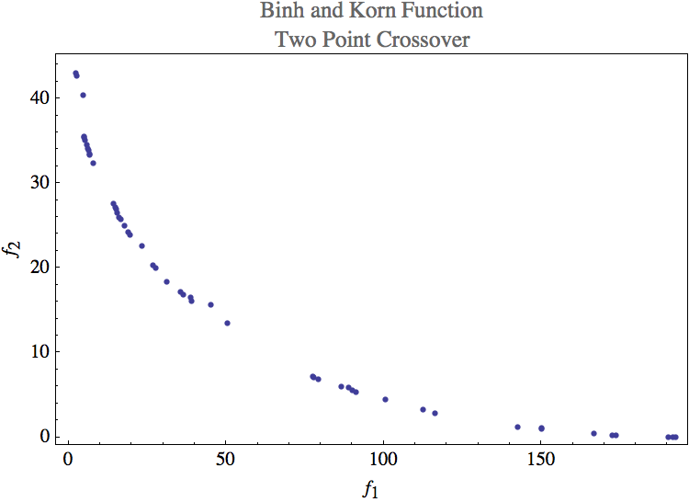
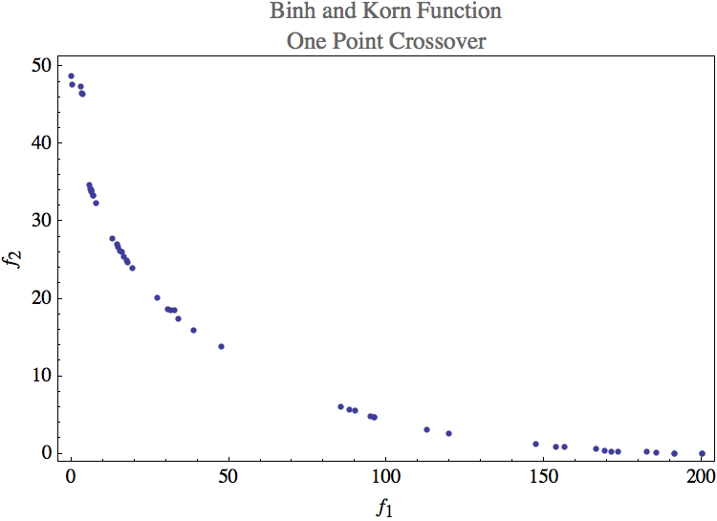
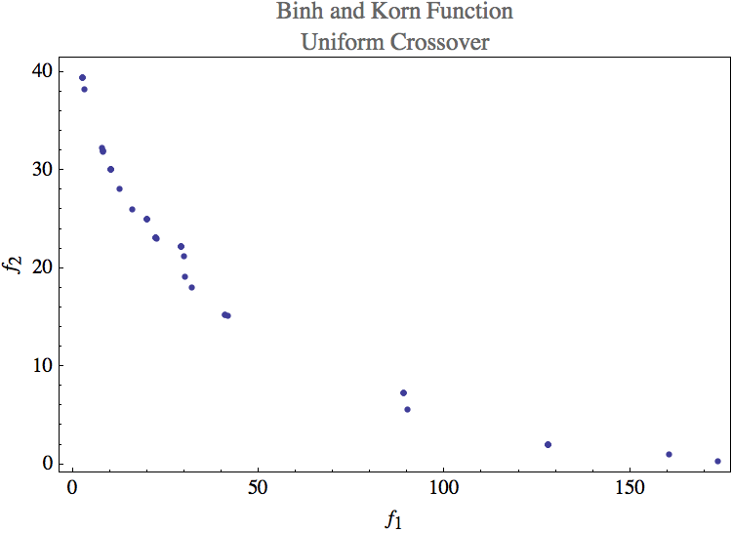
Crossover Results

Slide 8

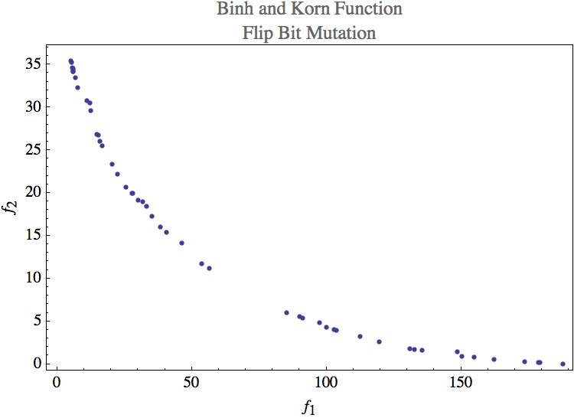
Mutation Results

Slide 9
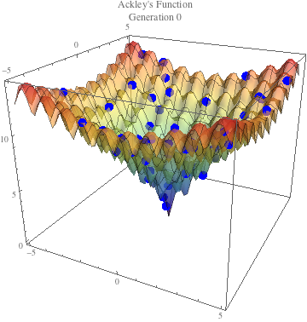
Results: Ackley’s Function

Slide 10
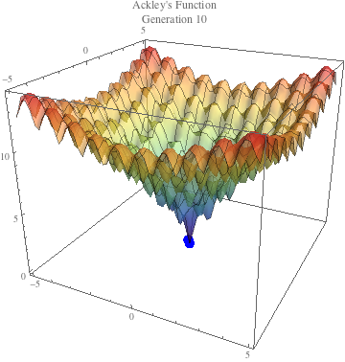
Results: Ackley’s Function

Slide 11


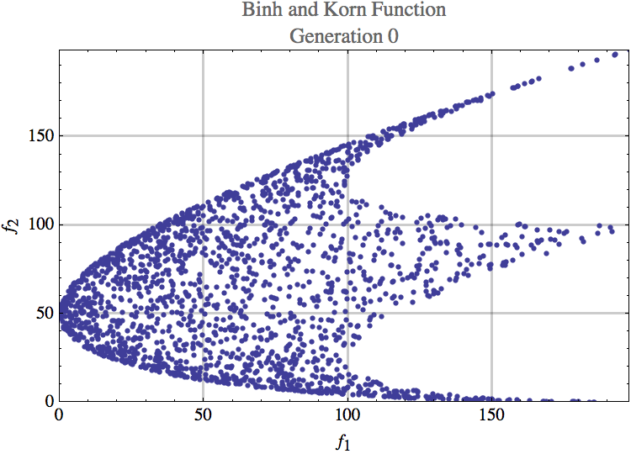
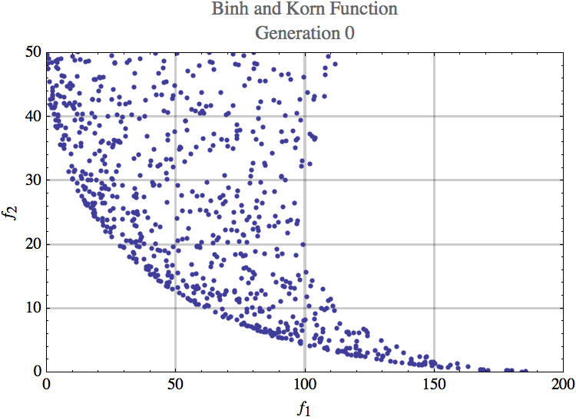
Results: Binh and Korn Function

Slide 12
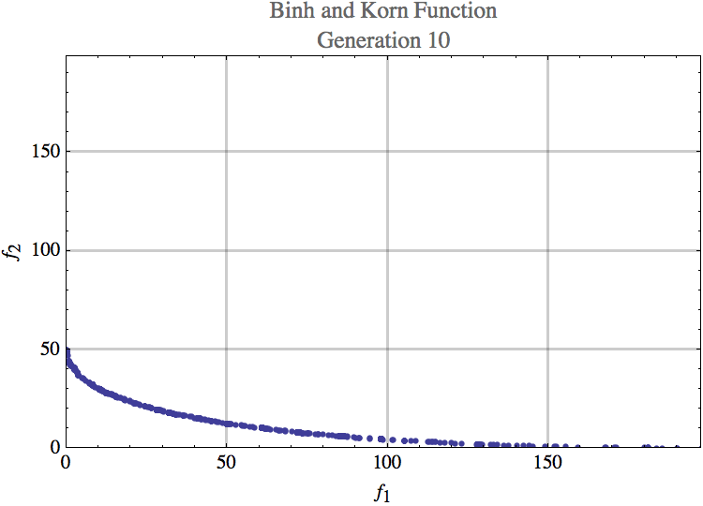
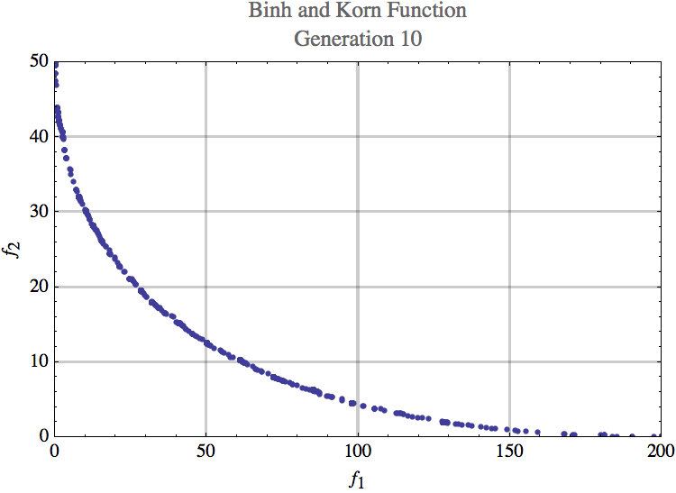
Results: Binh and Korn Function

Slide 13
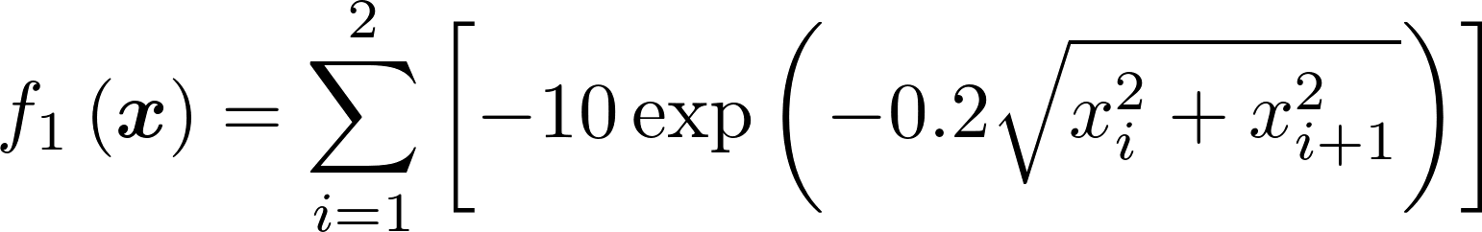
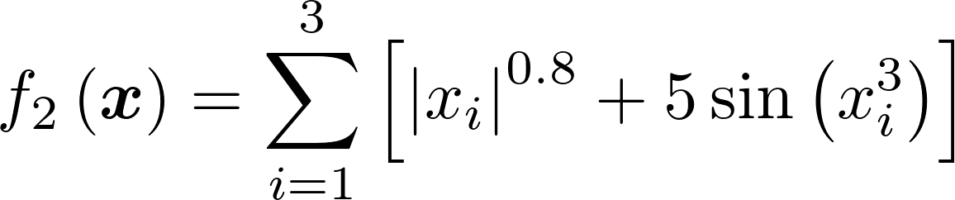

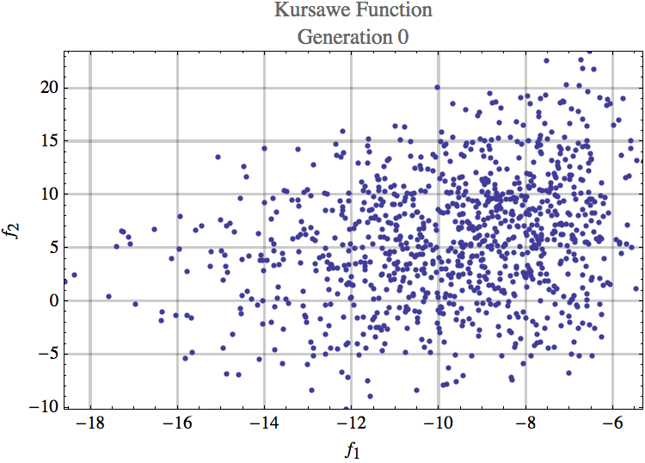
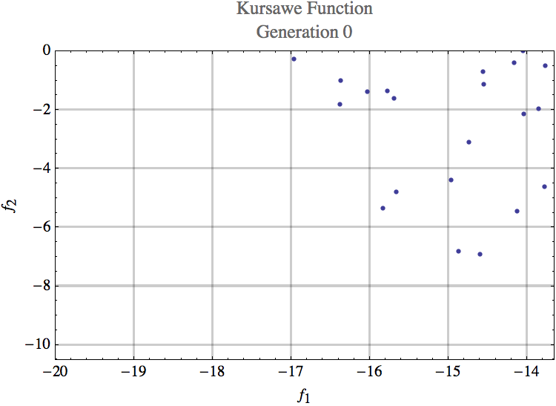
Results: Kursawe Function

Slide 14
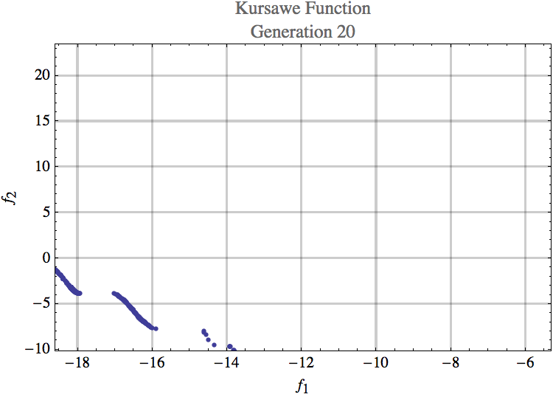
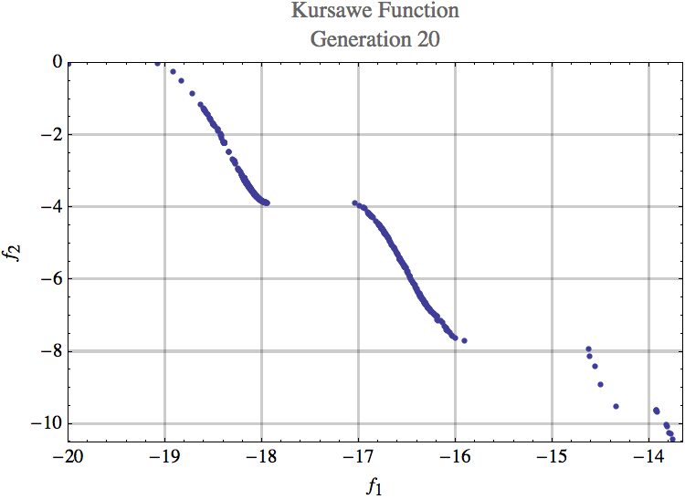
Results: Kursawe Function

